Slide 1
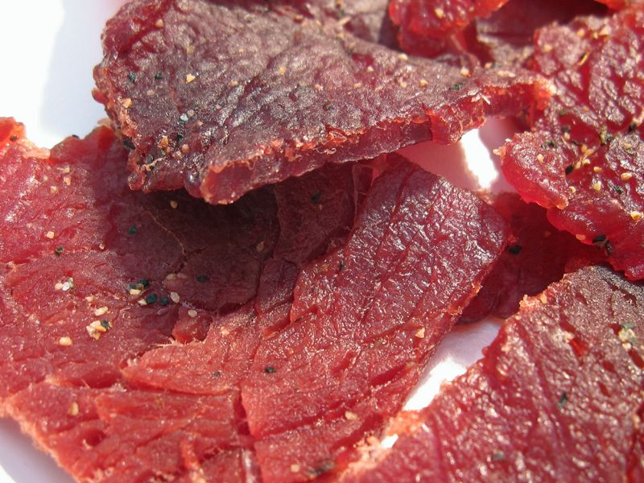
Jerky Demonstration Montana 2019
Jon Frohling
ScottPec, Inc.
Rapid City, SD

Slide 2
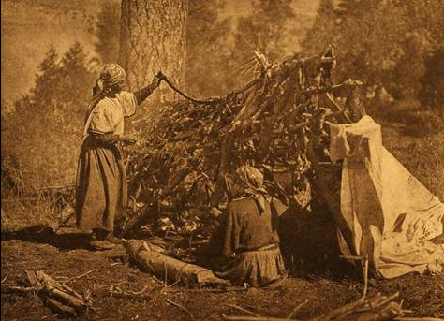
History of Jerky

Slide 3
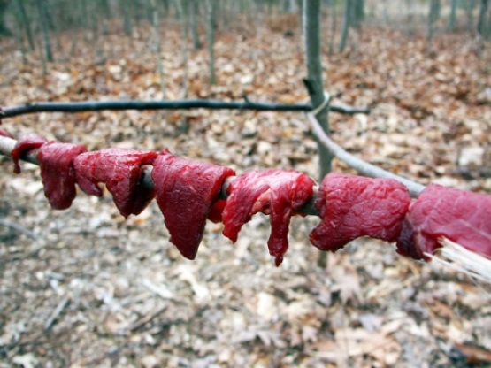
History
DRIED MEAT
Native Americans ---Pemmican
Hispanics---Carne Seca
Spanish—Charque
PRESERVED THE MEAT
Migrators Used
Light and Easy
High Protein
MARKETING
Sold to the Hudson Bay Company
Next to Furs, Pemmican was largest industry for the Native Americans

Slide 4
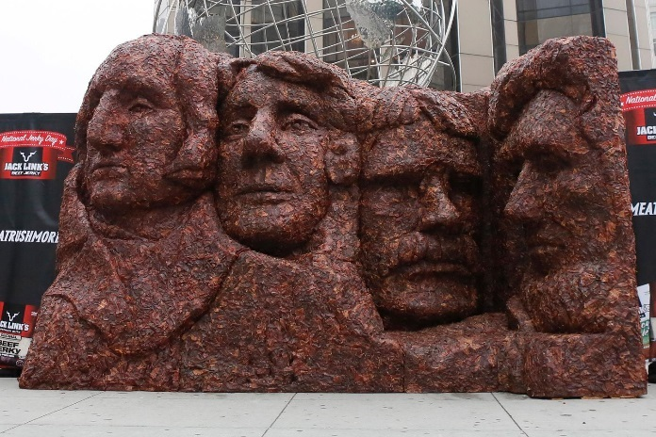
Current Trend
TODAY
Methods of Preparation are Much Different
PRESERVED THE MEAT
Still used for People Traveling with No Refrigeration
Light and Easy
High Protein
MARKETING
374 Billion Dollar Global Per Year
1.5 Billion Dollar Industry Per Year for Jack Links
Up 13% in the last 3 years
1 in Ten People say they eat Snacks instead of Cooking Food

Slide 5
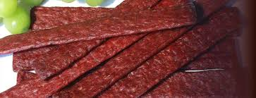
Ground and Formed Jerky

Slide 6
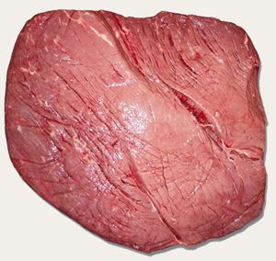
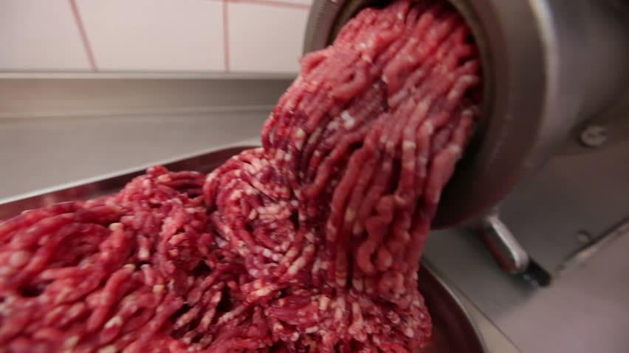
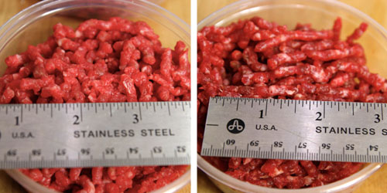
Meat Preparation

Slide 7
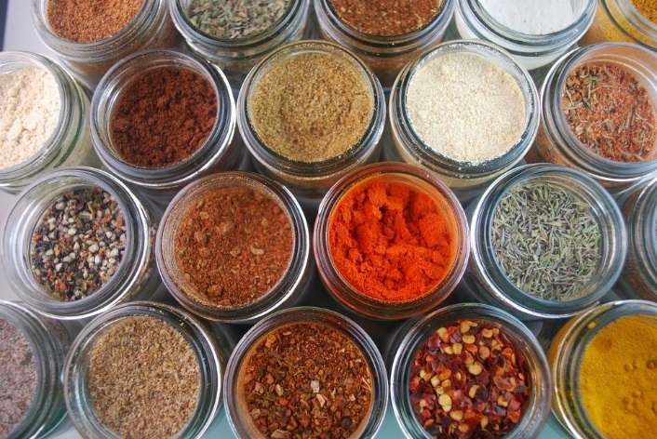
Seasoning Prep
Add All Spices Except Sugar into Mixing Container
Add 1 Gallons of Water Per 100lbs of Meat total
Mix Spices and 1/2 Gallon of Water Thoroughly with a Wisk
Dissolve Sugar in a Separate Container with 1/2 Gallon of Water
Combine all Seasoning, Sugar and Water into 1 Container and Mix
Put into Mixer

Slide 8
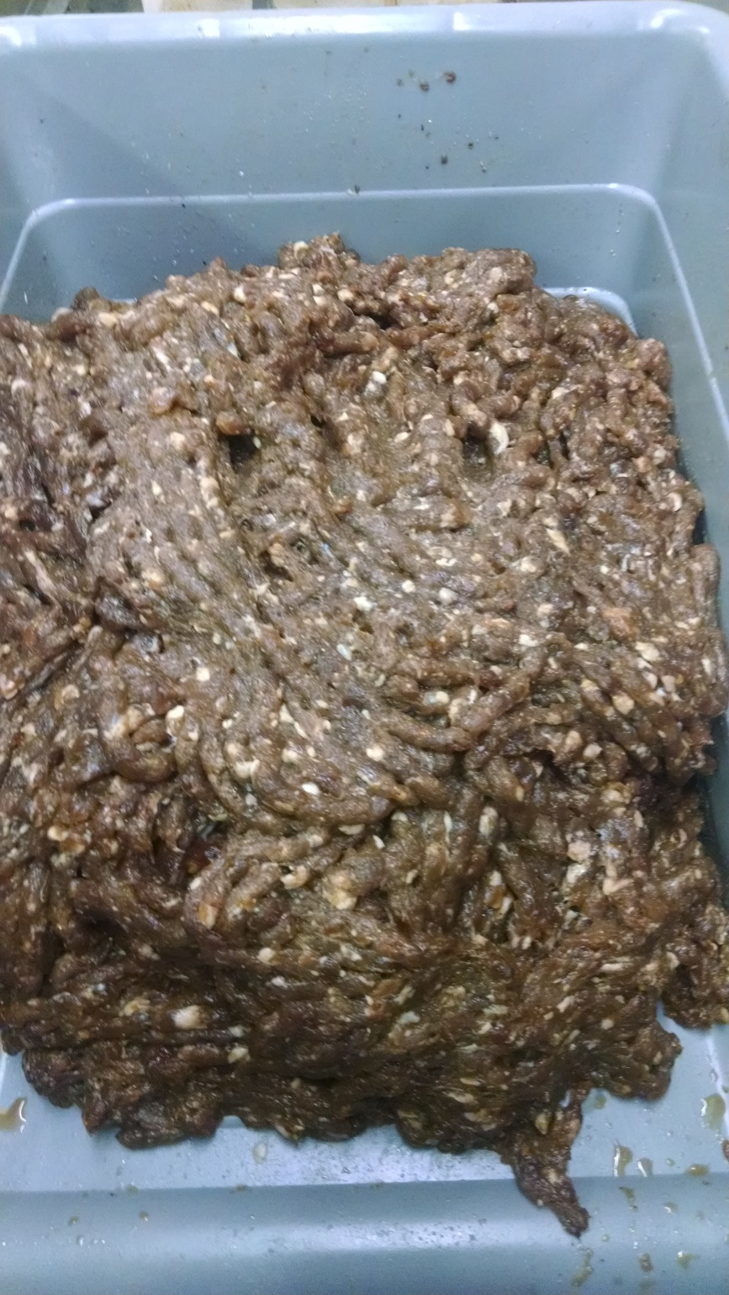
Mixing
Mix All Ingredients in Mixer for 2-3 Minutes
Cure Overnight in the Cooler or go Directly to the Grinder for a Final Grind
Final Grind Size Depends on Customer Preference
Stuff

Slide 9
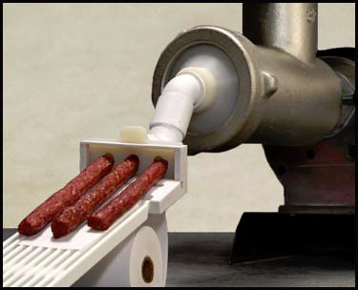
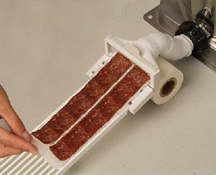
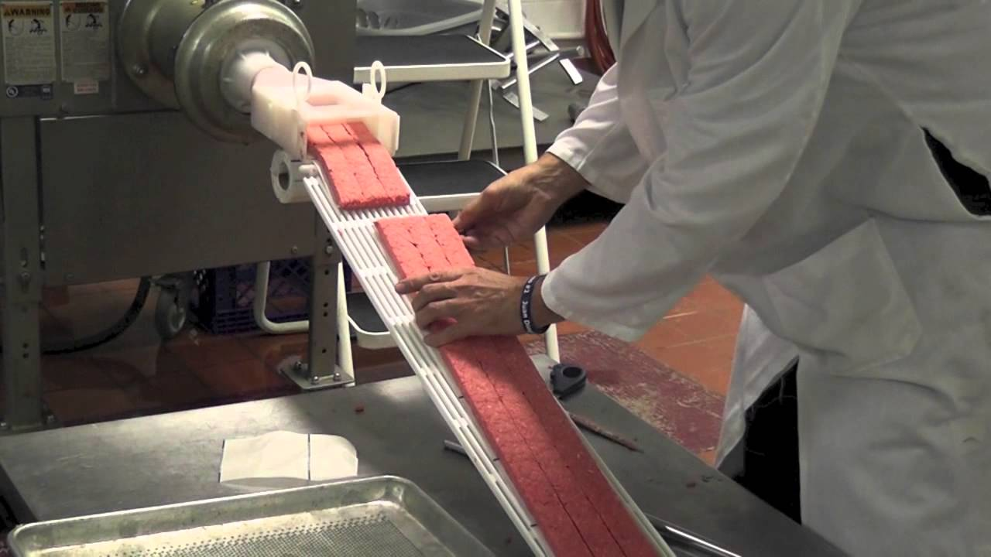
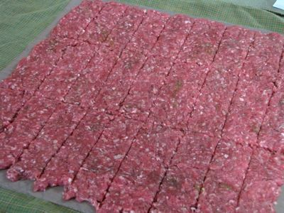
Stuffing

Slide 10
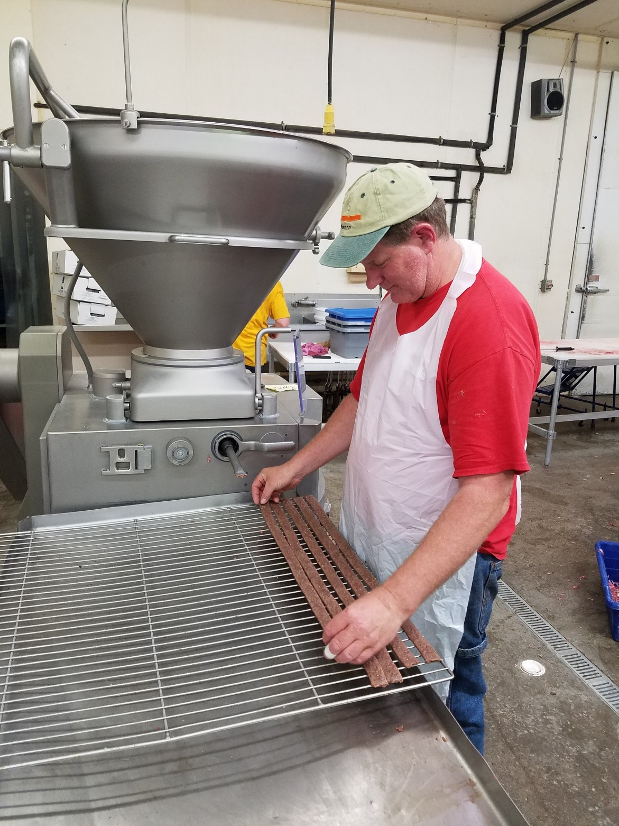
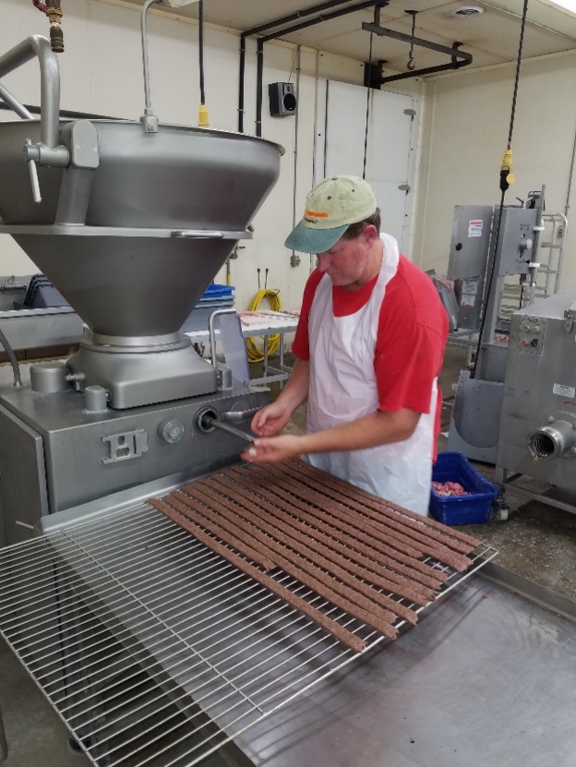
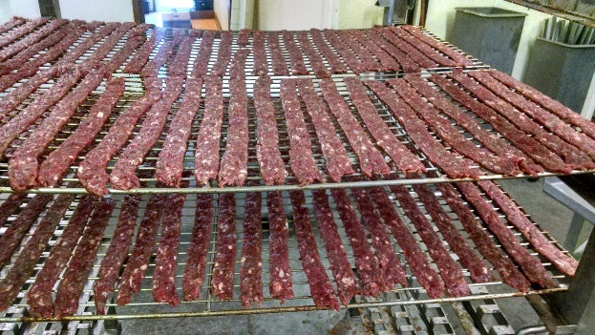
Stuffing

Slide 11
Smoking/Cooking Jerky
STEP | PROCESS | DAMPER | TIME | DRY BULB ⁰F | WET BULB ⁰F | HUMIDITY | CORE
1. | Curing (Fan on High Speed) | Open | 1.5 Hrs | 110° | 0 | 0 | 0
2. | Smoke Ignition | Open | :04 | 135° | 0 | 0 | 0
3. | Smoking | Auto | :10 | 140° | 0 | 0 | 0
4. | Drying (Fan on High Speed) | Open | :15 | 145° | 0 | 0 | 0
5. | Cook (High Fan) | Closed | :30 | 150° | 127° | 50% | 170°
6. | Cook (High Fan) | Closed | :30 | 155° | 131° | 50% | 170°
7. | Cook (High Fan) | Closed | To Internal (Aprox 10 minutes) | 175° | 166° | 80% | 165°
8.` | Drying (High Fan) | Open | To Desired Water Activity | 150° | 0 | 0
This Smoking/Cooking Program only Works on Products Where Nitrites are Added

Slide 12
Smoking/Cooking Jerky
STEP | PROCESS | DAMPER | TIME | DRY BULB ⁰F | WET BULB ⁰F | HUMIDITY | CORE
1. | Drying (Fan on High Speed) | Open | :30 | 110° | 0 | 0 | 0
2. | Smoke Ignition | Open | :04 | 135° | 0 | 0 | 0
3. | Smoking | Auto | :10 | 140° | 0 | 0 | 0
4. | Cook (High Fan) | Closed | :30 | 150° | 127° | 50% | 170°
5. | Cook (High Fan) | Closed | :30 | 155° | 131° | 50% | 170°
6. | Cook (High Fan) | Closed | To Internal (Aprox 10 minutes) | 175° | 166° | 80% | 165°
7. | Drying (High Fan) | Open | To Desired Water Activity | 155° | 0 | 0

Slide 13
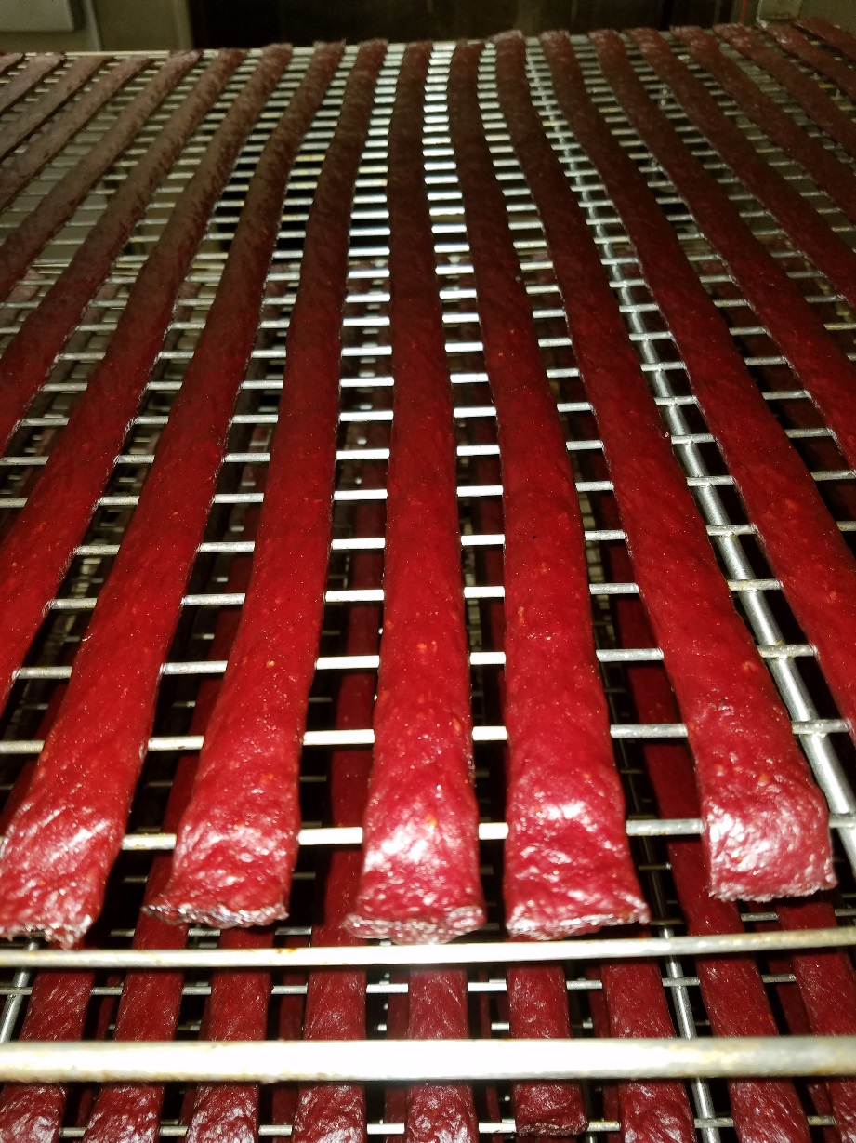
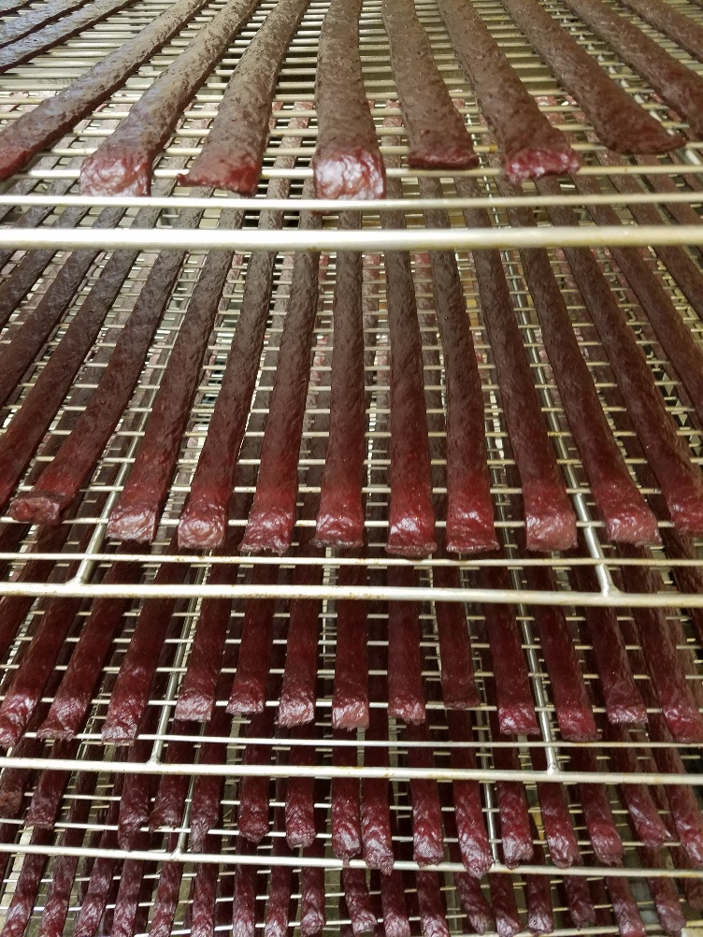
Finished Product

Slide 14
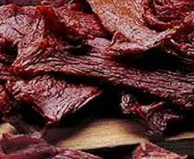
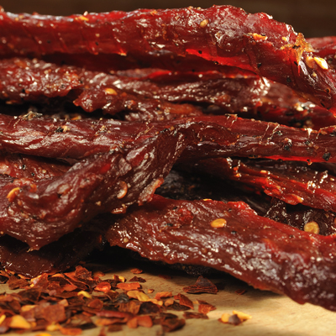
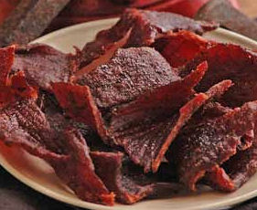
Whole Muscle Jerky

Slide 15
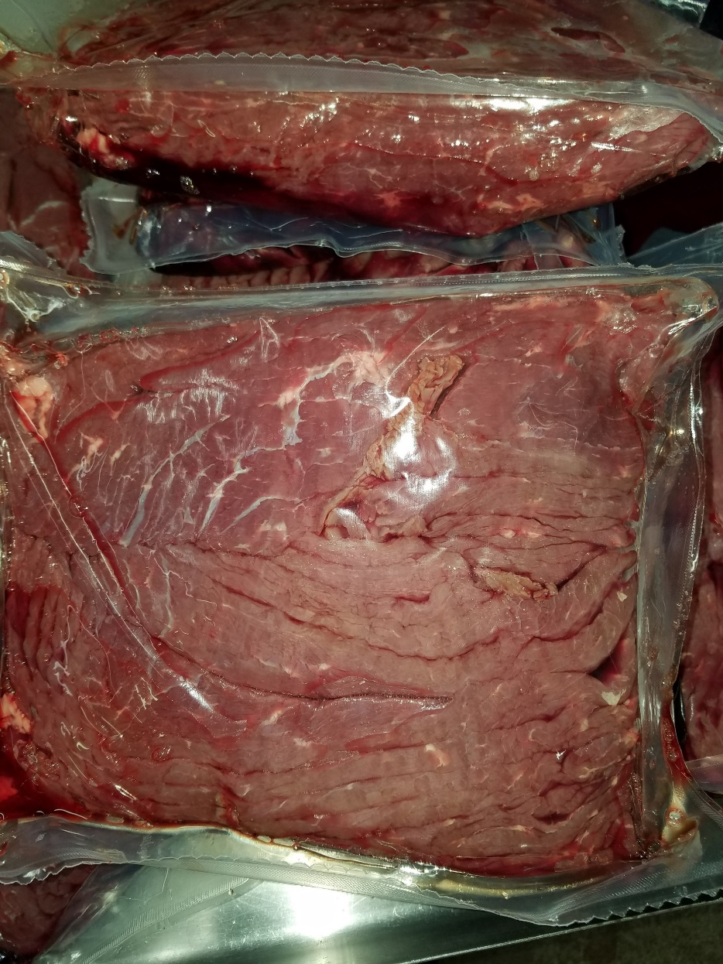
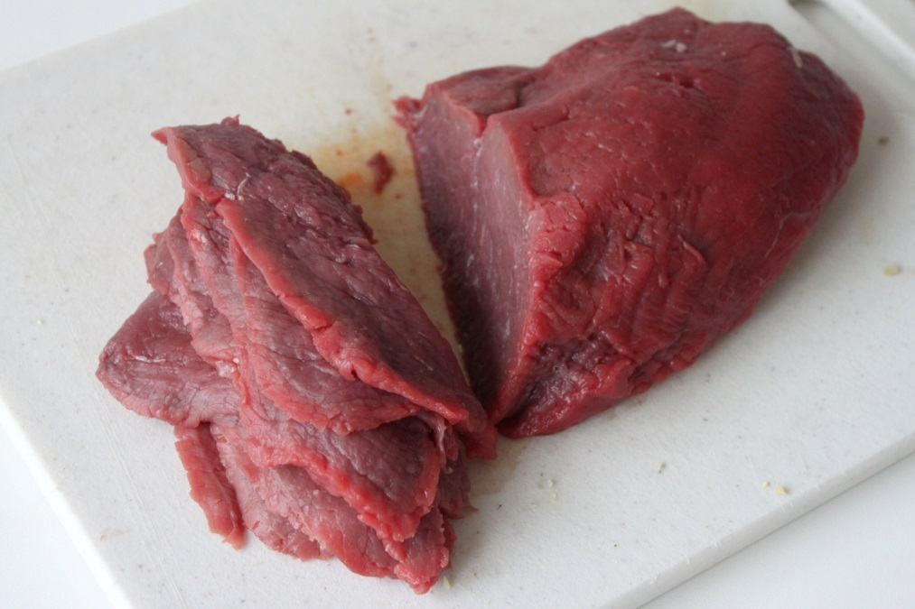
Meat Preparation
Pre-Sliced Cow Rounds
Slice Yourself (Industry Standard ¼”)

Slide 16
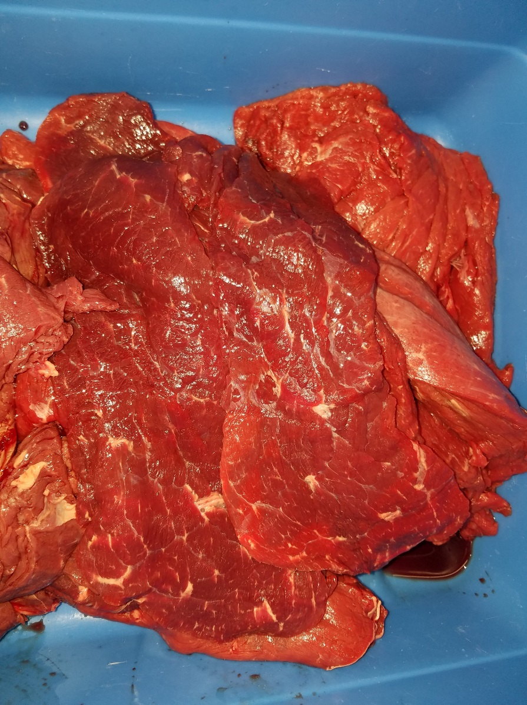
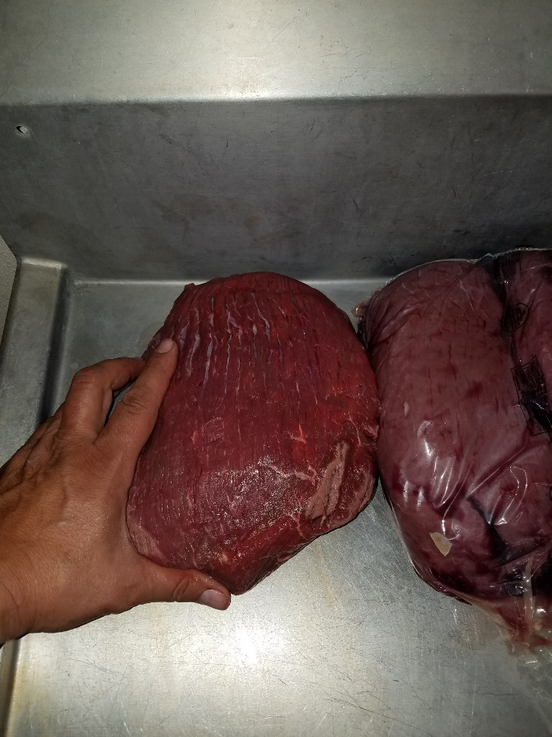
Meat Quality
Cow Rounds
Dark Cutter

Slide 17
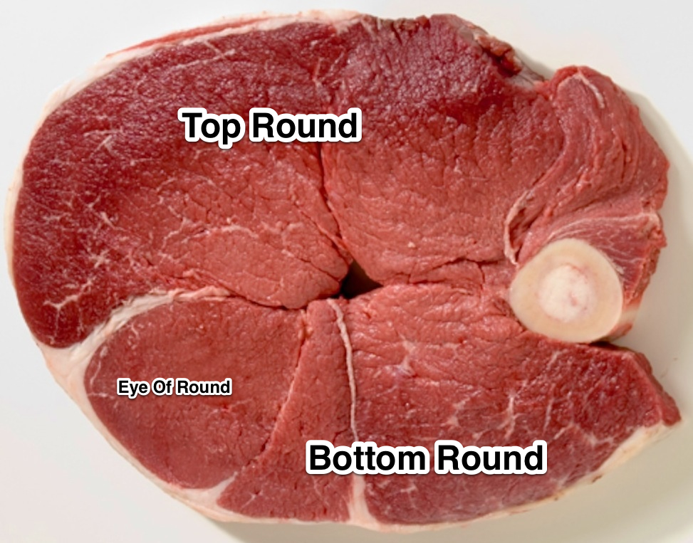
Meat Quality

Slide 18
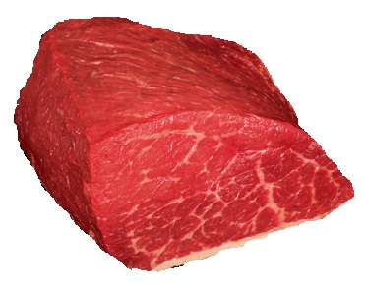
Meat Quality

Slide 19
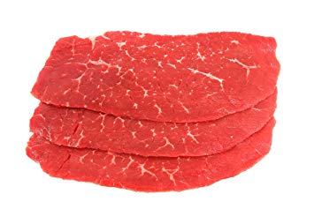
Meat Quality

Slide 20
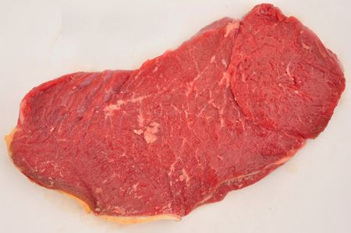
Meat Quality

Slide 21
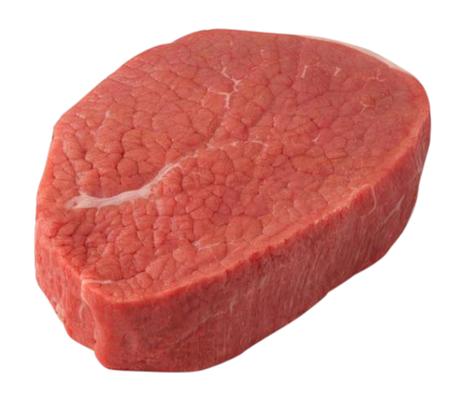
Meat Quality

Slide 22
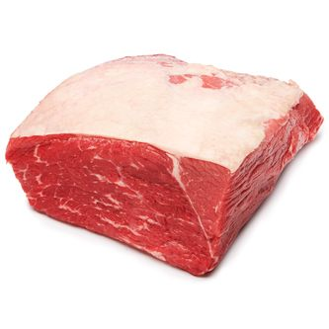
Meat Quality

Slide 23
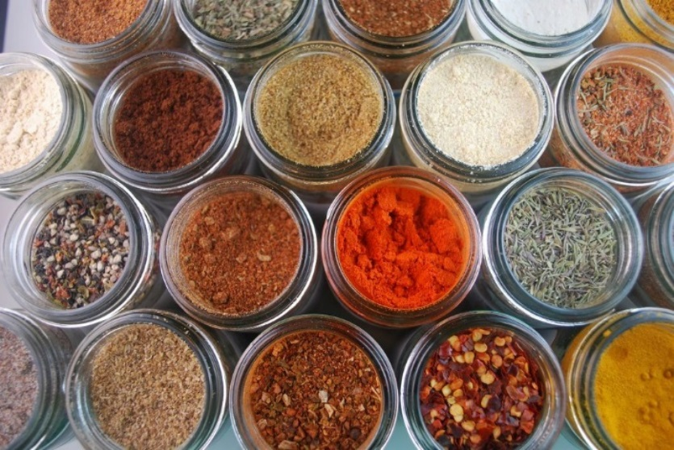
Seasoning Prep
Add All Spices Except Sugar into Mixing Container
Add 2 Gallons of Water Per 100lbs of Meat total
Mix Spices and 1 Gallon of Water Thoroughly with a Wisk
Dissolve Sugar in a Separate Container with 1 Gallon of Water
Combine all Seasoning, Sugar and Water into 1 Container and Mix
Put into Tumbler----If you are using the recipes as a brine or marinade (cut back on water)

Slide 24
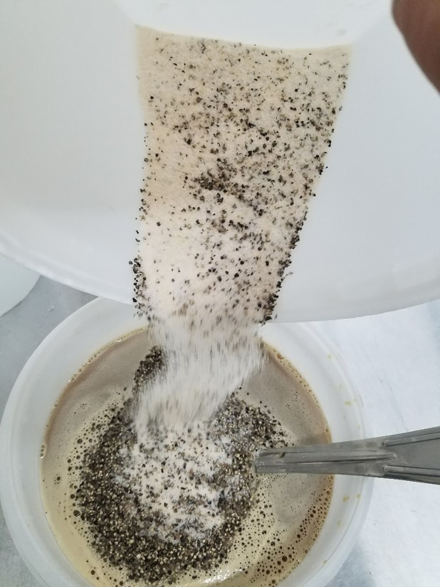
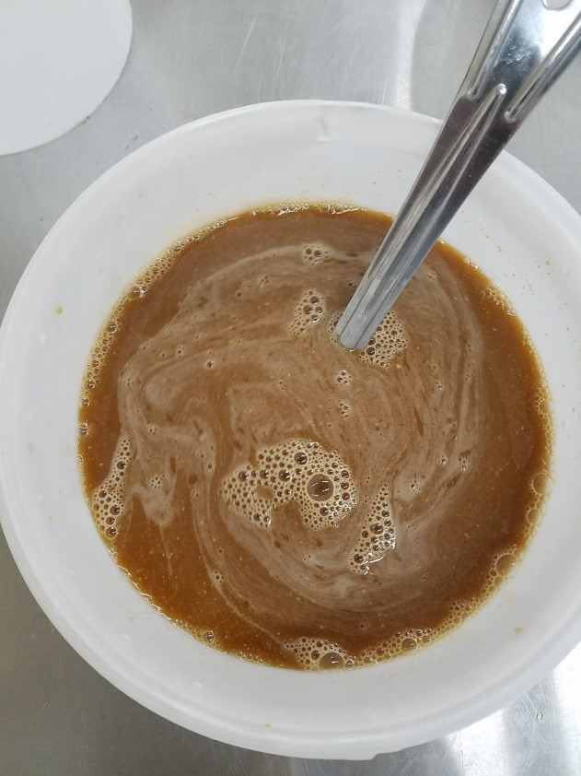

Slide 25
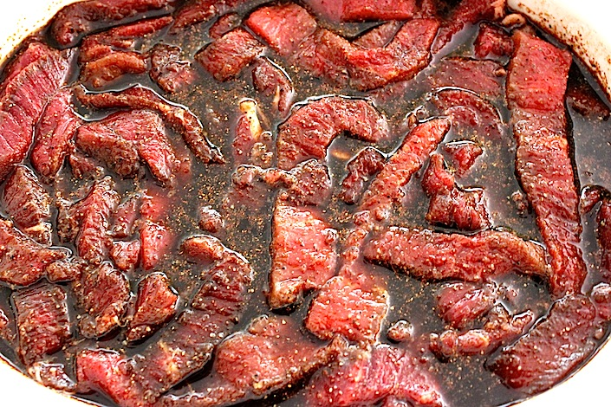
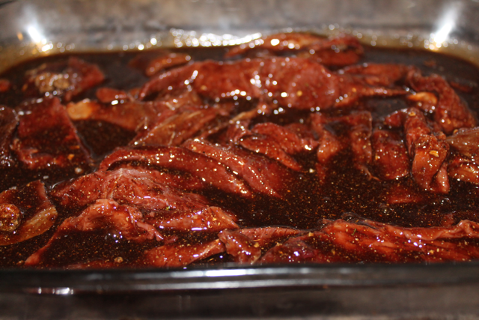
Brine

Slide 26
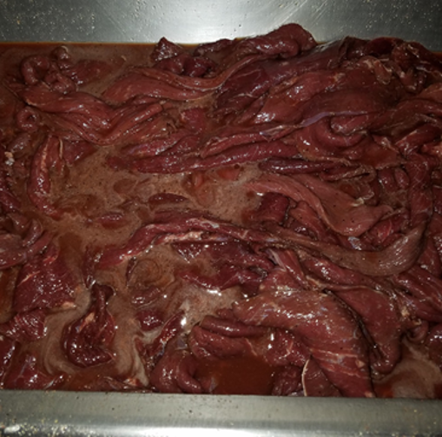
How Much Water

Slide 27
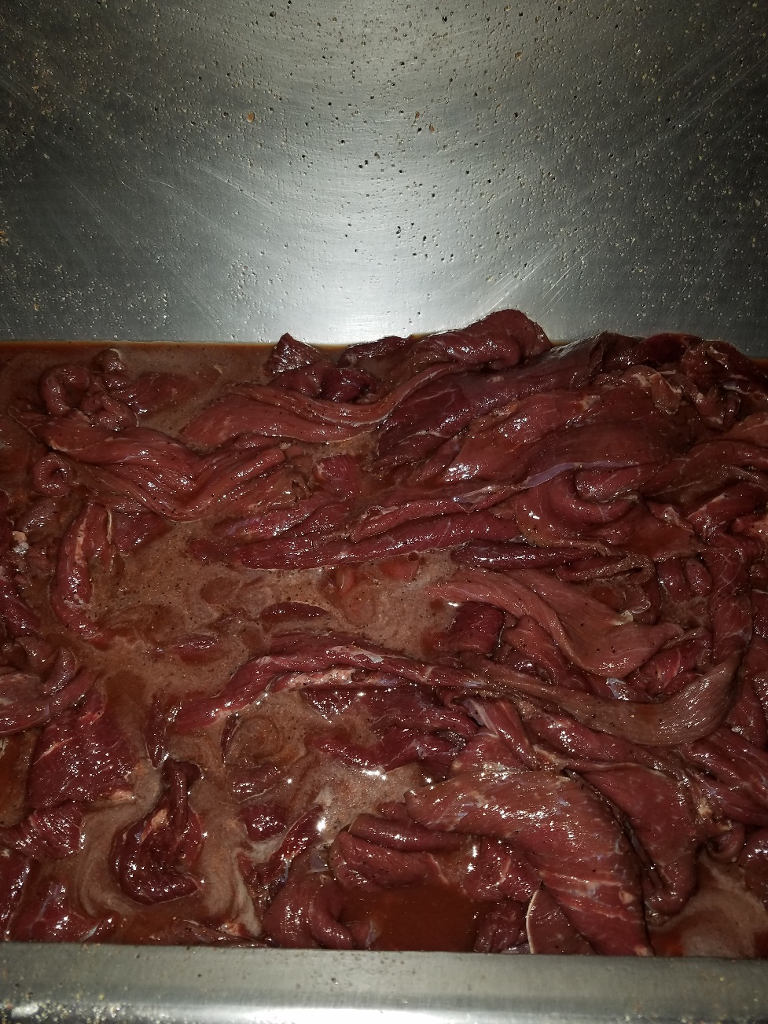
Pre-Tumble
Make Sure all of the Sliced Muscle are Separated before you Start the Tumbling Process

Slide 28
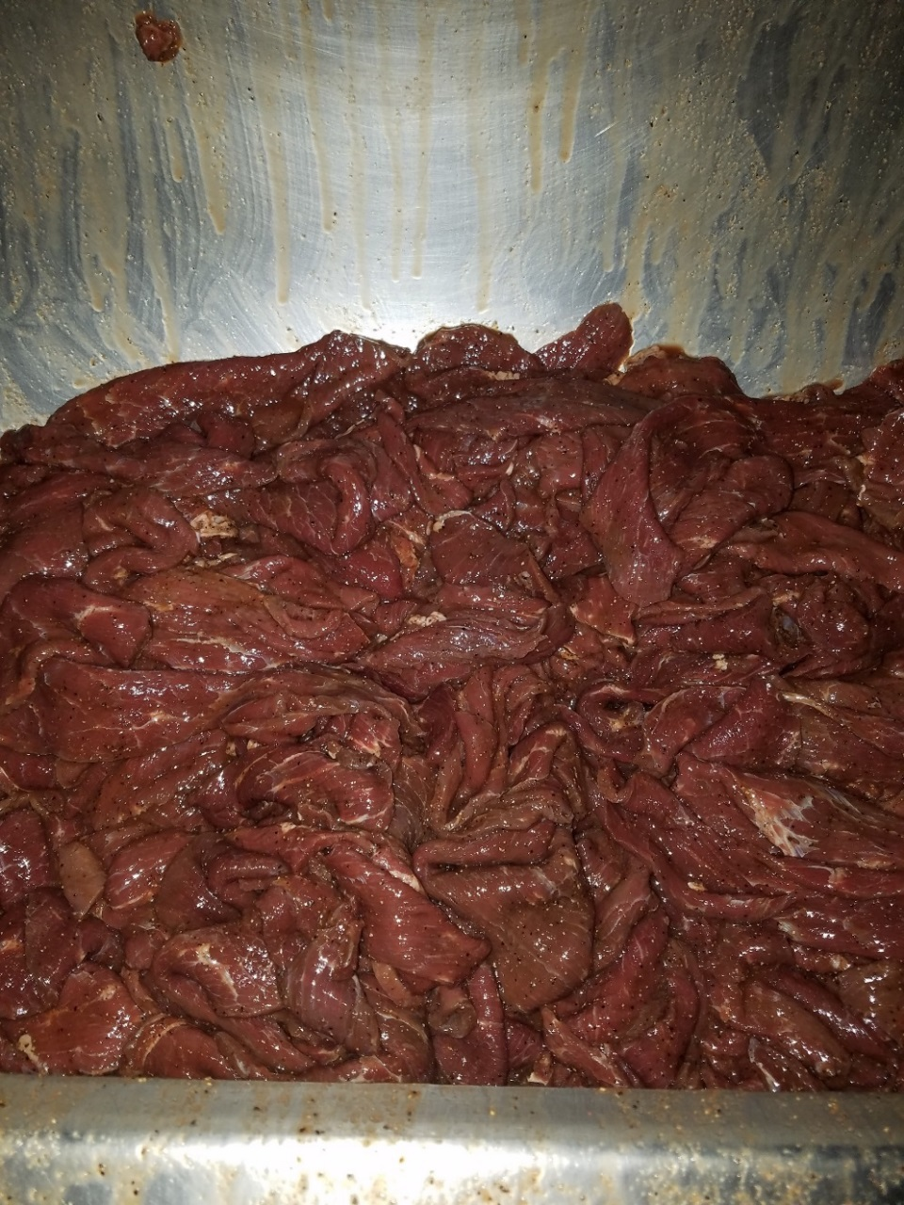
Tumbled Jerky
Tumbling Times Will Vary on Equipment.
This Batch was Tumbled for 8 minutes at 10 rev/minute with no Vacuum
All of the Liquid was Picked Up but there is not a lot of Protein Extraction
Too much Protein Extraction will Change the Texture of the Finished Product and Make Screening a Lot More Difficult

Slide 29
How to Make Your Vertical Flow Oven Cook Jerky Better
Overloading Screens
Chimney Down the Center of the Screens
Hanging increases Amount of Product in House and Evenness of Cooking
Horizontal Flow Smokehouse Versus Vertical Flow Smokehouse

Slide 30
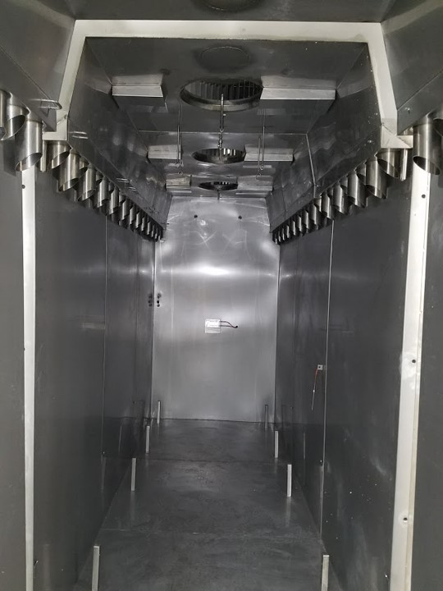
Horizontal vs Vertical

Slide 31
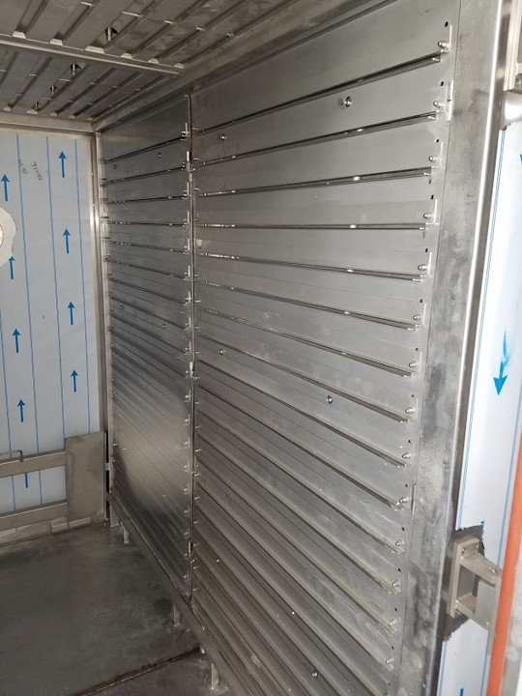
Horizontal vs Vertical

Slide 32
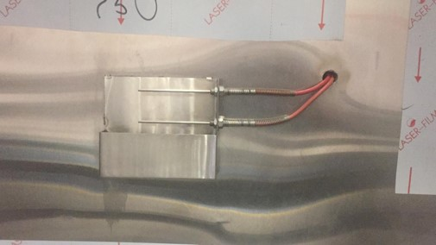
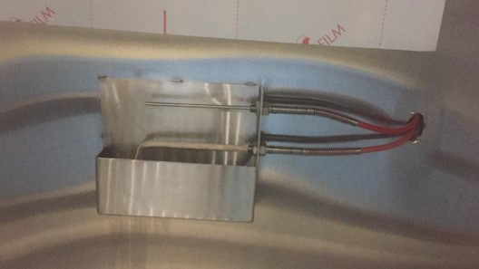
IMPORTANT!!

Slide 33
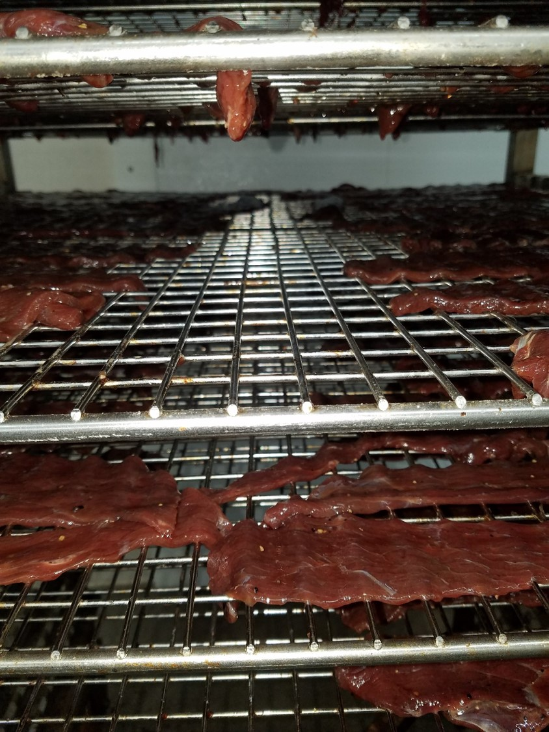
Chimney Down the Center of the Screens

Slide 34
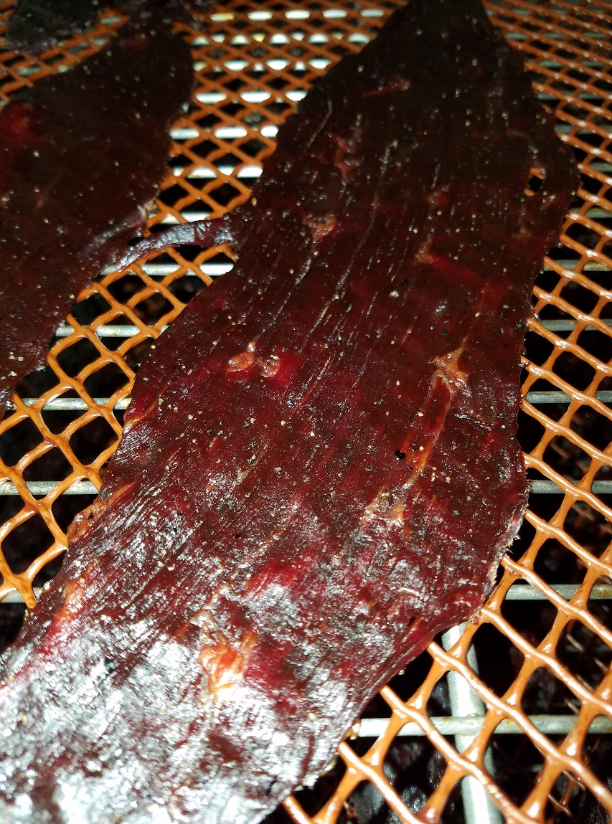
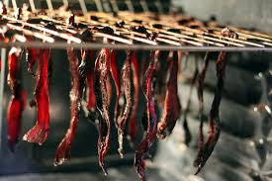
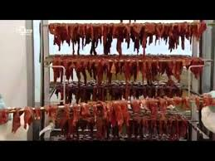
Screening/Hanging

Slide 35
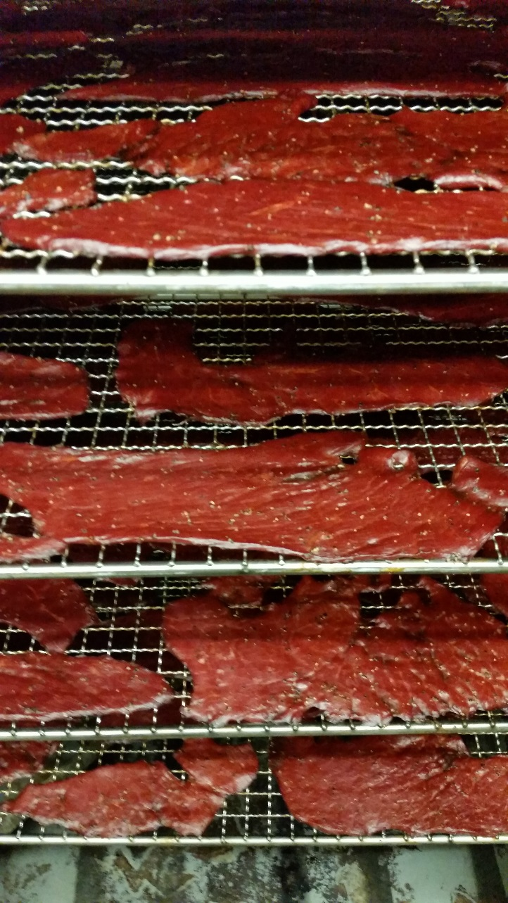
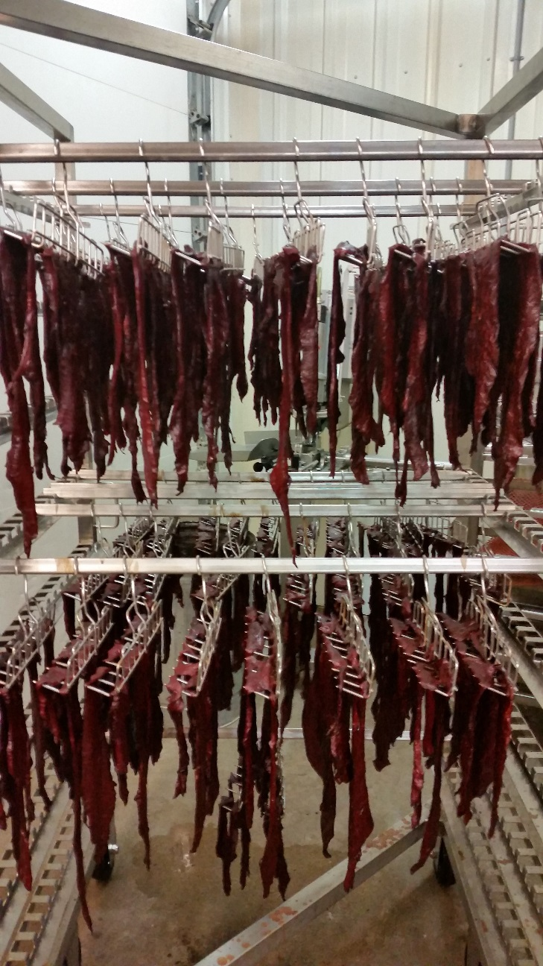
Screening/Hanging

Slide 36
Screening/Hanging

Slide 37
Screening/Hanging

Slide 38
Screening/Hanging

Slide 39
Screening/Hanging

Slide 40
Finished Product

Slide 41
Finished Product

Slide 42
Finished Product

Slide 43
Smoking/Cooking Jerky
STEP | PROCESS | DAMPER | TIME | DRY BULB ⁰F | WET BULB ⁰F | HUMIDITY | CORE
1. | Curing (Fan on High Speed) | Open | 1.5 Hrs | 110° | 0 | 0 | 0
2. | Smoke Ignition | Open | :04 | 135° | 0 | 0 | 0
3. | Smoking | Auto | :10 | 140° | 0 | 0 | 0
4. | Drying (Fan on High Speed) | Open | :15 | 145° | 0 | 0 | 0
5. | Cook (High Fan) | Closed | :30 | 150° | 127° | 50% | 170°
6. | Cook (High Fan) | Closed | :30 | 155° | 131° | 50% | 170°
7. | Cook (High Fan) | Closed | To Internal (Aprox 10 minutes) | 175° | 166° | 80% | 165°
8.` | Drying (High Fan) | Open | To Desired Water Activity | 150° | 0 | 0

Slide 44
Smoking/Cooking Jerky
STEP | PROCESS | DAMPER | TIME | DRY BULB ⁰F | WET BULB ⁰F | HUMIDITY | CORE
1. | Drying (Fan on High Speed) | Open | :30 | 110° | 0 | 0 | 0
2. | Smoke Ignition | Open | :04 | 135° | 0 | 0 | 0
3. | Smoking | Auto | :10 | 140° | 0 | 0 | 0
4. | Cook (High Fan) | Closed | :30 | 150° | 127° | 50% | 170°
5. | Cook (High Fan) | Closed | :30 | 155° | 131° | 50% | 170°
6. | Cook (High Fan) | Closed | To Internal (Aprox 10 minutes) | 175° | 166° | 80% | 165°
7. | Drying (High Fan) | Open | To Desired Water Activity | 155° | 0 | 0

Slide 45
Smoking/Cooking Jerky
STEP | PROCESS | DAMPER | TIME | DRY BULB ⁰F | WET BULB ⁰F | HUMIDITY | CORE
1. | Drying (Fan on High Speed) | Open | :15 | 135° | 0 | 0 | 0
2. | Cook (High Fan) | Closed | :30 | 150° | 127° | 50% | 170°
3. | Cook (High Fan) | Closed | :30 | 155° | 131° | 50% | 170°
4. | Cook (High Fan) | Closed | To Internal (Aprox 10 minutes) | 185° | 166° | 80% | 165°
5. | Drying (High Fan) | Open | :15 | 175° | 0 | 0 | 0
6. | Smoke Ignition | Auto | :5 | 150° | 0 | 0 | 0
7. | Smoke | Auto | :12 | 150° | 0 | 0 | 0
8. | Drying (Slow Fan) | Open | To Desired Water Activity | 175° | 0 | 0 | 0

Slide 46
Appendix A
USDA Cooking Document
Close the oven dampers to provide a closed system and prevent moisture loss. This would meet the requirements of Appendix A provided that the oven remains sealed for 50% of the cooking time and no less than 1 hour; OR
Continuously introducing steam for 50% of the cooking time, but in no case less than 1 hour; OR
If the relative humidity of the oven is maintained at 90% or above for at least 25% of the total cooking time, but in no case less than 1 hour
You must meet at least one of these Guidelines

Slide 47
Food Safety Requirements for Shelf Stability
Water Activity < .85 (with packaging or other possible intervention)
Water Activity < .70 (without packaging----i.e. exposed to the air)

Slide 48
Water Activity Meters
Two Different Meters Were Used to Ensure Accuracy

Slide 49
Improving Yields
Control Batch Jerky
 | Lbs of Product |  | Cost | Extended Price
No Roll Cow Rounds | 100.00 |  | $4.05 | 405.00
Salt | 2.00 |  | $0.54 | 1.08
Brown Sugar | 1.00 |  | $1.00 | 1.00
Pink Cure | 0.25 |  | $0.78 | 0.20
Black Pepper (course) | 0.50 |  | $7.72 | 3.86
Granulated Onion | 0.09 |  | $3.46 | 0.31
Granulated Garlic | 0.09 |  | $6.70 | 0.60
Sodium Erythorbate | 0.05 |  | $3.34 | 0.17
 |  |  | $0.00 | 0.00
 | 0.00 |  | $0.00 | 0.00
Bromelain | 0.00 |  | $35.00 | 0.00
Lemon Juice | 0.00 |  | $2.40 | 0.00
Lime Juice | 0.00 |  | $2.72 | 0.00
Apple Cider Vinegar | 0.00 |  | $4.37 | 0.00
Pineapple Juice | 0.00 |  | $4.80 | 0.00
 |  |  | $0.00 | 0.00
 |  |  | $0.00 | 0.00
Total Gross Weight | 103.98 |  | Total Cost | $412.22
Finished Product Weight | 41.90 |  | Cost Per Lb. | $9.84
Yield | 40%
Desired Mark UP | 0
Retail Price | $25.00
Control Batch-Shelf Stable Jerky-Water Activity .74

Slide 50
Improving Yields
20% Sugar Batch Jerky
 | Lbs of Product |  | Cost | Extended Price
No Roll Cow Rounds | 100.00 |  | $4.05 | 405.00
Salt | 2.00 |  | $0.54 | 1.08
Brown Sugar | 20.00 |  | $1.00 | 20.00
Pink Cure | 0.25 |  | $0.78 | 0.20
Black Pepper (course) | 0.50 |  | $7.72 | 3.86
Granulated Onion | 0.09 |  | $3.46 | 0.31
Granulated Garlic | 0.09 |  | $6.70 | 0.60
Sodium Erythorbate | 0.05 |  | $3.34 | 0.17
 |  |  | $0.00 | 0.00
 | 0.00 |  | $0.00 | 0.00
Bromelain | 0.00 |  | $35.00 | 0.00
Lemon Juice | 2.50 |  | $2.40 | 6.00
Lime Juice | 0.00 |  | $2.72 | 0.00
Apple Cidar Vinegar | 2.50 |  | $4.37 | 10.93
Pine Apple Juice | 0.00 |  | $4.80 | 0.00
 |  |  | $0.00 | 0.00
 |  |  | $0.00 | 0.00
Total Gross Weight | 127.98 |  | Total Cost | $448.14
Finished Product Weight | 70.40 |  | Cost Per Lb. | $6.37
Yield | 55%
Desired Mark UP
Retail Price | $25.00
Control Batch-Shelf Stable Jerky-Water Activity .68

Slide 51
Analysis
 | Beginning Weight 100# Meat plus Seasonings | Finished Weight After Cooking | Water Activity | Total Profit— Gross Profit at $25.00/Jerky Minus Cost
Control Batch | 103.98 | 41.90 | .74 | $635.28
10% Sugar Batch | 115.48 | 56.35 | .78 | $976.61
20% Sugar Batch | 127.98 | 70.40 | .68 | $1311.86

Slide 52
Other Things you Can Do to Make Sure Your Product is Safe
Oxygen Absorbers
Spray with Antimicrobial (Potassium Sorbate)
Vacuum Sealing Packages
Gas Flushing Packages
ALWAYS Wear Sterile Gloves when working with Finished Product
Time From Finish Cook to Packaging

Slide 53
Flavorings
Turkey Jerky
CHICKEN
Pork Jerky
Bacon Jerky

Slide 54
Turkey Jerky
CHICKEN
Trouble Shooting-Mold

Slide 55
Trouble Shooting-Mold
CHICKEN

Slide 56
Trouble Shooting
Turkey Jerky
CHICKEN
Salts or sugars — If too much salt or sugar is used in the brine/marinade formula, then when the product is dried, these ingredients concentrate and at a critical moisture level crystalize on the surface of the product. Brine formulations yield about 9 to 20% ingredients in the dried jerky product. Those products that have above 10% ingredients tend to have more problems with film formation. Usually, this is caused by the extra sugar that is added, but not always.

Slide 57
Trouble Shooting
Turkey Jerky
CHICKEN
Tyrosine crystals — Tyrosine, an amino acid, may be the problem. Just as tyrosine crystals form in cheese as it is dried, they can form on the surface of meat also. Usually this occurs more on the sliced surfaces of country-style hams and a solid white film that looks like slime or mold, but is actually tyrosine. I have no suggestions for solving this problem.

Slide 58
Trouble Shooting
Turkey Jerky
CHICKEN
Sodium nitrite — Some processors have reported that sodium nitrite precipitates on the surface of jerky if “hard” water with excessive amounts of iron is used to formulate brine. This would appear as a white film and would be rare, but possible.

Slide 59
Trouble Shooting
Turkey Jerky
CHICKEN
Jerky too dry — If the jerky is dried excessively, concentrating the ingredients can sometimes cause crystallization of the ingredients and a white film on the surface. Back off on the drying cycle to see if this helps.

Slide 60
MARKETING

Slide 61
Are there Any Questions?

