Slide 1
Best Business Practices Hiring and Retaining Employees Chris Young AAMP Executive Director

Slide 2
Where have all the workers gone?
The #1 issue facing our industry is the lack of workers to fill a growing need.
1. Jobs in our Industry Require Hard Work.
2. Work Ethic has changed with time.
3. There’s a lot of competition for Workers

Slide 3
Where to look for workers?
We need to be creative and look outside the box.
1. Correctional Institutions- Work Release
2. Local Trade Schools
3. Culinary Schools
4. High School Tech Programs- Senior early
release
5. Internships

Slide 4
Where to look for workers?
We need to be creative and look outside the box.
5. Use Temp Agency
a. Less risk
6. Employee Referral Program
a. $150.00 after 30 days
b. $150.00 after 90 days

Slide 5
How to Hire the Right One
You need a Formulized Hiring Process
1. Proper Application
2. Job Descriptions
3. Interview Process
a. Questions
b. Who does the interview

Slide 6
How to Hire the Right One
Interviewing Basics
Be consistent in the questions you ask each candidate
Ask only questions that are job related
You can always listen
Questions that reveal a candidate’s age, race, national origin, gender, religion, marital status, sexual orientation, or other trait that is protected by state or federal law should be avoided

Slide 7
Interview Question Do’s & Don’ts
Family and Relationship Status Questions to Avoid
Are you married?
How many children do you have?
What are your childcare arrangements?
Are you planning on getting married or having any children?
Are you in a relationship?
Allowable Questions
This job requires working nights, rotating shifts, weekends, and holidays. Are you willing to do this?

Slide 8
Interview Question Do’s & Don’ts
Don’t ask anything health related!
How’s your family medical history?
Are you on any medication?
Have you had any recent operations or hospitalizations?
Do you have any disabilities?
Have you ever been injured at work/filed worker’s comp claim?

Slide 9
Interview Question Do’s & Don’ts
Allowable Questions
Are you able to perform the essential functions of the job with or without a reasonable accommodation?
Have you ever been disciplined for violating a workplace safety rule? What did you learn from the incident?

Slide 10
Interview Question Do’s & Don’ts
Avoid Questions Relating to Heritage and Religion
Where were you born?
Where is your accent from?
Are you a U.S. citizen?
Were your parents born in the U.S.?
Do you observe any holidays because of your religious affiliation or beliefs?

Slide 11
Interview Question Do’s & Don’ts
Allowable Questions
Are you legally authorized to work in the U.S.?
This job requires working nights, rotating shifts, weekends, and holidays. Are you willing to do this?

Slide 12
Interview Question Do’s & Don’ts
Questions Relating to Age Are Off Limits
“How much longer do you plan to work?
“What are your retirement goals?”
“What year did you graduate from high school, college?”
“What year were you born?”
Allowable Questions
What are your career goals?
Tip: Federal law prohibits age discrimination against people over 40.

Slide 13
Interview- Criminal Background
EEOC has made “eliminating hiring barriers,” such as exclusion of candidates because of criminal history, a key priority
Must maintain confidentiality of criminal background information
Blanket exclusions because of criminal history prohibited
Must make individualized assessment:
Nature/gravity of offense
Time passed since offense
Nature of job sought
Individualized assessment and consistency key

Slide 14
Interview-Post Offer Med Exam
The ADA prohibits disability-related inquiries or medical exams before an offer of employment is made
However, an employer may condition a job offer on passing a post-offer medical exam/inquiry
Same medical exam/inquiry must be required of all employees in the same job category
If an individual is not hired based on medical exam/inquiry, reason(s) must be job-related and consistent with business necessity

Slide 15
Retaining Employees/Team Members
“ Our Employees are our most valuable asset”
How many times have you heard this from an owner or manager of a business?
A growing shortage of qualified applicants makes this a reality for most employers
Despite increasing difficulty recruiting & retaining employees, little effort has been made by most employers to demonstrate they truly value those “assets”.

Slide 16
Retaining Employees/Team Members
Money isn’t EVERYTHING!
1. A recent survey shows that most managers & supervisors believe that what matters most to employees are tangible things like:
a. Wages
b. Benefits
c. Promotions

Slide 17
Retaining Employees/Team Members
Money isn’t EVERYTHING!
2. Contrary to that belief, studies have for years confirmed that what is most important to the majority of employees is:
a. a boss that genuinely cares about them
b. a boss that is fair
c. a boss that makes them feel a part of the company.

Slide 18
Retaining Employees/Team Members
How do you create employee goodwill & caring workplace culture?
It is easier than you think.
a. Good morning, Thank you
2. Be Sincere
3. Every day make employees a paramount concern

Slide 19
Retaining Employees/Team Members
How do you create employee goodwill & caring workplace culture?
4. “There is nothing that I do that is more important than talking with our employees”. Quote from a man who built a fortune 500 company.
5. Invest the time- Hiring more employees is a waste of time if you cannot retain the ones you have

Slide 20
Retaining Employees/Team Members
How else can you show appreciation?
Incentive programs
a. Low cost/ Big Dividends
Small Gestures
a. Feed them
b. Time off
Make Employees Team Members
a. Communicate important information

Slide 21
Retaining Employees/Team Members
How else can you show appreciation?
Personal Experience- I ran a beef Jerky company for 18 years.
Went from a handful of Employees to over 100 team members
If a new hire lasted 30 days, we had a 90% retention rate.

Slide 22
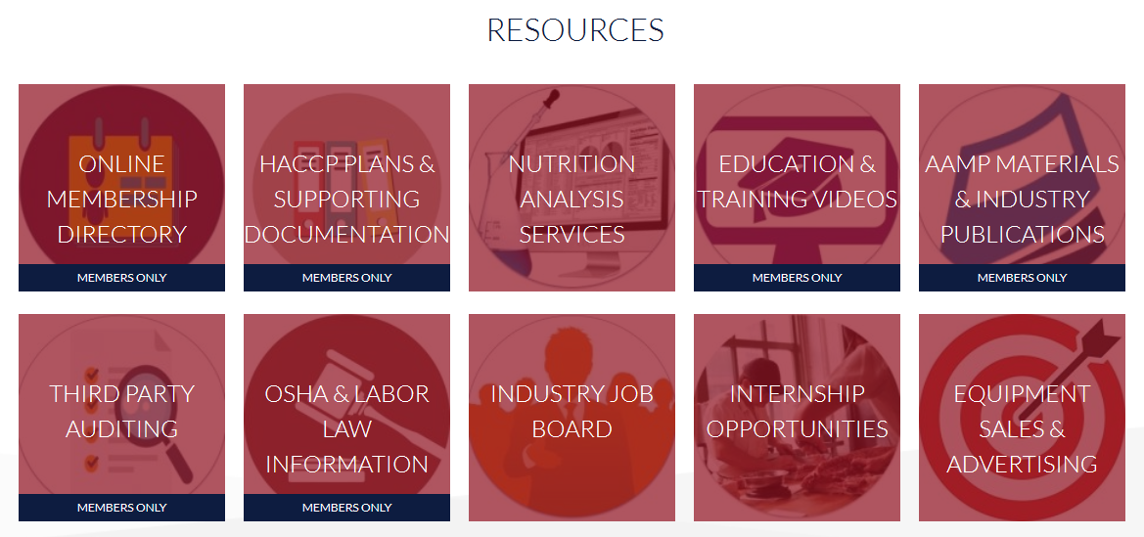

Slide 23
Labor law Resources
OSHA
Hiring of Minors
Auditing- I-9 Forms Etc.
Donning & Doffing
Job Interviews
Workplace Policies

Slide 24
Labor law Resources
Employee Wages
Records Retention
Workplace Posters
Employee Handbook
Contact Information- Richard Alaniz

